Slide 1

Validate Configured Subscription YANG-Push Publisher Implementations IETF 123 Hackathon, July 19-20th 2025
NMOP & NETCONF WG

Slide 2

Hackathon Plan, Software and Website
Test Plan
Subscription automation
Discover YANG-Push systems and notifications capabilities and configure periodical and on-change subscriptions with netconf.
Notification integration
Validate subscription state change and push-update and push-change-update notifications against schema with yanglint
Validate draft-ietf-nmop-message-broker-telemetry-message for draft-ietf-nmop-yang-message-broker-integration integration
Development Plan
MVP 1 – Basic Requirements (9)
MVP 2 – Scale and Secure (3)
MVP 3 – Optimizations (2)
Software
YANG-Push Publisher - Cisco IOS XR
YANG-Push Publisher - 6WIND VSR
YANG-Push Publisher - Huawei NE (Router) and MA (OLT)
YANG-Push Receiver – Netgauze
udp-notif dissector - Wireshark
NMOP & NETCONF WG
https://www.network-analytics.org/yp/how-to-deploy.html

Slide 3
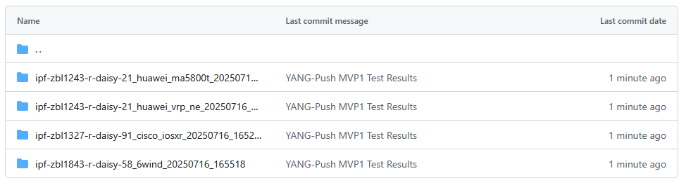
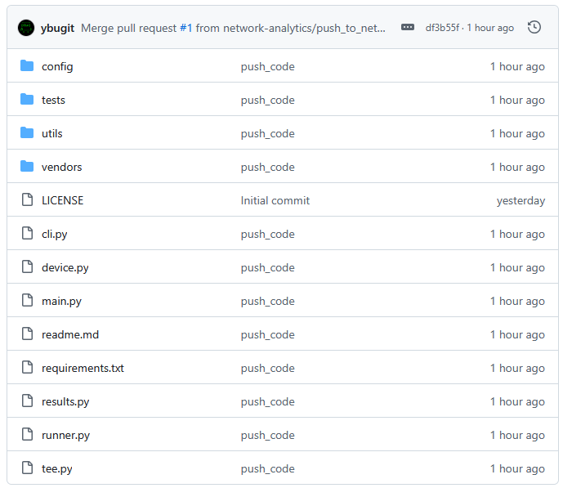
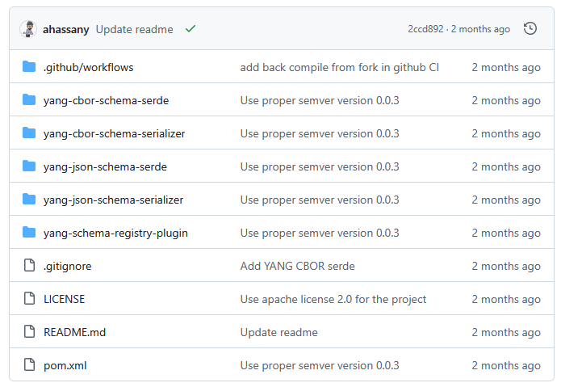
Hackathon – Repositories
Test Result Repository
https://github.com/network-analytics/ietf-network-analytics-document-status/tree/main/123/Hackathon
Packet capture on the wire
Netconf RPCs and YANG-Push JSON and CBOR encoded messages
Test Tool Repository
https://github.com/network-analytics/yp_test
YANG-Push Test Automation Tool
Vendor deviations configuration
Apache Kafka Integration
https://github.com/network-analytics/yang-kafka-integration
YANG Serializer
YANG Schema Registry Plugin
NMOP & NETCONF WG

Slide 4
An Architecture for YANG-Push to Message Broker Integration draft-ietf-nmop-yang-message-broker-integration draft-ietf-nmop-message-broker-telemetry-message
+------------------------------------------------------------+
| Data Storage |
+------------------------------------------------------------+
^
| (12) Ingest Data
| According to Schema
+------------------------------------------------------------+
| Data Consumer |
+------------------------------------------------------------+
| ^ ^
(10) Get | | | (9) Validate
Schema | | | Serialized Message
| | | Schema on Consumer
| | +--------------------+
| | | Message |
| | | Broker |
| | +--------------------+
| | ^
| | | (8) Serialize
| | (11) Issue | YANG-Push Message
| | Schema | annotated Schema
v | (6) Post | ID on Producer
+--------------------+ Schema +--------------------+
| YANG | <--------------- | Data Collection |
| Schema Registry | ---------------> | YANG-Push Receiver |
+--------------------+ (7) Issue +--------------------+
Schema ID | ^ (3) Receive
| | YANG-Push
(4) Discover | | Subscription
Schema | | Start Message
Dependencies | | ^
and Obtain | | | (5) Publish
Schemas | | | YANG-Push
| | | Message
| | | with
(1) Discover | | | Subscriber
Notification v | | ID
+--------------------+ Capabilities +--------------------+
| Manage YANG-Push | ---------------> | Network Node |
| Subscription | ---------------> | YANG-Push Publisher|
+--------------------+ (2) Subscribe +--------------------+
Subscription to YANG Notifications RFC 8639
Subscription to YANG Notifications for Datastore Updates RFC 8641
UDP-based Transport for Configured Subscriptions draft-ietf-netconf-udp-notif
Subscription to Distributed Notifications draft-ietf-netconf-distributed-notif
Extensible YANG Model for YANG-Push Notifications draft-ietf-netconf-notif-envelope
Support of Versioning in YANG Notifications Subscription draft-ietf-netconf-yang-notifications-versioning
YANG Modules Describing Capabilities for Systems and Datastore Update Notifications RFC 9196
YANG Notification Transport Capabilities draft-ietf-netconf-yp-transport-capabilities
YANG Library RFC 8525
Augmented-by Addition into the IETF-YANG-Library draft-ietf-netconf-yang-library-augmentation
Encoding of Data Modeled with YANG in the CBOR RFC 9254
NMOP & NETCONF WG

Slide 5
Register new YANG schema - Payload
The same rest API as other formats such as AVRO, JSON, and ProtoBuf is used to register new YANG schemas.
{
"schemaType": "YANG",
"references": [
{
"name": "other-module-name",
"subject": "registered subject name",
"version": "registered version",
}
],
"schema": "... yang schema text"
}
NMOP & NETCONF WG
my-module-request.json
curl -X POST \
-H "Content-Type: application/vnd.schemaregistry.v1+json"
-d @my-module-request.json \
http://localhost:8081/subjects/my-module/versions

Slide 6
Retrieve new YANG schema
Retrieve all registered schemas
curl http://localhost:8081/subjects/
Retrieve all registered version of a given subject
curl http://localhost:8081/subjects/my-module
Retrieve a specific version of a schema registry
curl http://localhost:8081/subjects/my-module/versions/1
Retrieve a schema by ID
http://localhost:8081/schemas/ids/1
{
"schemaType": "YANG",
”subject": "my-module",
"version": 1,
”id": 1,
"references": [
{
"name": "other-module-name",
"subject": "registered subject name",
"version": "registered version",
}
],
"schema": "... yang schema text"
}
NMOP & NETCONF WG
Result of getting schema from schema registry

Slide 7
Apache Kafka wire format
Data is encoded in native YANG format (json, cbor, xml).
Schema ID is included in the header.
Content type is encoded in the header using the standard allocated in IANA (RFC8040 and RFC9254)
{
”headers": [
"schema-id": 1, // schema id registered
"content-type": "application/yang-data+json"
]
"paylod": ..json encoded YANG,
}
NMOP & NETCONF WG
Apache Kafka message value and headers

Slide 8
YANG-Push Test Setup
NMOP & NETCONF WG

Slide 9
YANG-Push Test Automation Tool – Usage 1
python3 main.py --config config/yp_test_config.yml --vendor cisco_iosxr --help
usage: yp_test [-h] --vendor {6wind,cisco_iosxr,huawei_vrp_ne} -c CONFIG [-u RECEIVER_USERNAME] [-i RECEIVER_INSTANCE_NAME] [--subscriptions] [--all] [--override_timer OVERRIDE_TIMER] [-v] [-vv]
[--tests TESTS [TESTS ...]] [--list-tests]
YANG Push Test Suite (modular, multivendor version)
optional arguments:
-h, --help show this help message and exit
--vendor {6wind,cisco_iosxr,huawei_vrp_ne}
Vendor name (choices: 6wind, cisco_iosxr, huawei_vrp_ne)
-c CONFIG, --config CONFIG
YAML config file
-u RECEIVER_USERNAME, --receiver-username RECEIVER_USERNAME
user used for SSH connection (overrides config file)
-i RECEIVER_INSTANCE_NAME, --receiver-instance-name RECEIVER_INSTANCE_NAME
YANG-Push receiver-instance-name (overrides config file)
--subscriptions
--all
--override_timer OVERRIDE_TIMER
-v, --verbose
-vv, --very_verbose
--tests TESTS [TESTS ...]
Select one or more tests or test sequences to run in order. Use --list-tests to see the choices.
--list-tests List all available tests and sequences, then exit.
enjoy
NMOP & NETCONF WG

Slide 10
YANG-Push Test Automation Tool – Usage 2
python3 main.py --config config/yp_test_config.yml --vendor cisco_iosxr --list-tests
Available tests:
yangpush_delete_subsciptions
yangpush_delete_receivers
netconf_get_discover_yang
netconf_get_ietf_notification_capabilities
netconf_get_ietf_system_version
netconf_get_ietf_yang_library_augmentedby
netconf_get_system_capabilities
netconf_get_yang_library
netconf_get_schema_ietf_notification_transport_capabilities
netconf_get_schema_ietf_udp_notif_transport
netconf_get_schema_ietf_yang_library_augmentedby
netconf_get_schema_ietf_yang_push
netconf_get_schema_ietf_yang_push_revision
netconf_get_schema_ietf_yp_notification
netconf_get_schema_ietf_yp_observation
netconf_get_schema_ietf_yp_transport_capabilities
netconf_get_schema_ietf_system_capabilities_yang
yangpush_add_receiver
yangpush_ietf_interface
yangpush_vendor_interface
netconf_get_schema_ietf_interfaces_yang
yangpush_get_subscriptions
yangpush_post_test_cleanup
Available test sequences:
MVP1
capabilities_sequence
NMOP & NETCONF WG

Slide 11
YANG-Push Test Automation Tool – Usage 3
python3 main.py --config config/yp_test_config.yml --vendor cisco_iosxr --tests netconf_get_discover_yang netconf_get_ietf_system_version
+------------------------------------------------------------------+
| Running tests for vendor: cisco_iosxr and hostname: 203.0.113.91 |
+------------------------------------------------------------------+
...Excempted for brevty...
--------------------------------------------------------------------------------
=== Test Results:
+---------------------------------+----------+------------+---------------------------------------------+
| Test | Status | Duration | Error |
+=================================+==========+============+=============================================+
| netconf_get_discover_yang | PASS | 1.36s | |
+---------------------------------+----------+------------+---------------------------------------------+
| netconf_get_ietf_system_version | FAIL | 0.02s | Received empty response for get-ietf-sys... |
+---------------------------------+----------+------------+---------------------------------------------+
Selected test sequences: []
Results saved in ./results/ipf-zbl1327-r-daisy-91_cisco_iosxr_20250627_201714
Results directory tree:
ipf-zbl1327-r-daisy-91_cisco_iosxr_20250627_201714/
stdout.log
yp_config_backup.xml
get-discover-yang.txt
yp_test.log
NMOP & NETCONF WG

Slide 12
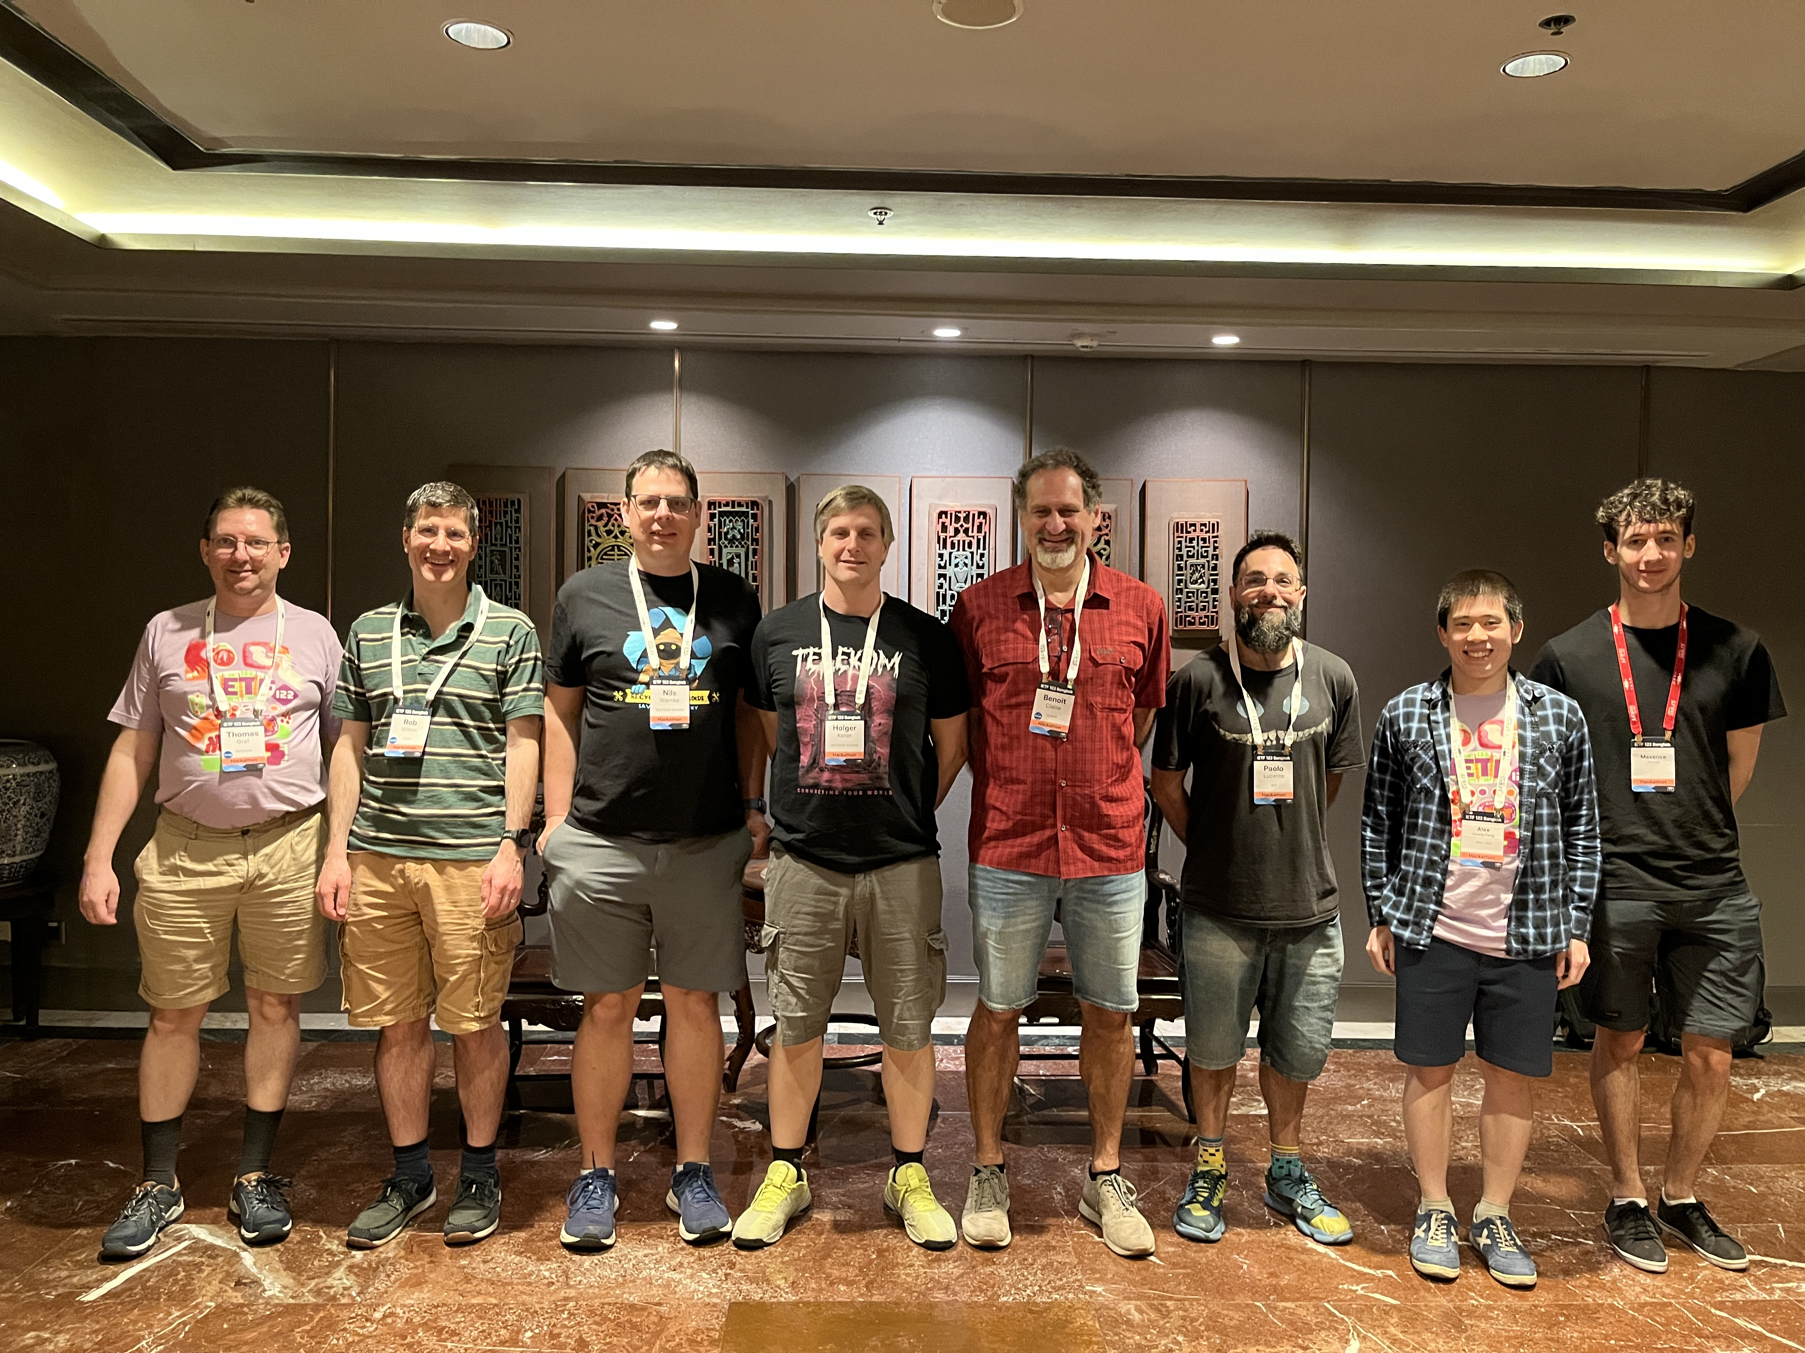
Thanks to…
Rob Wilton – Cisco
Nick Corran – Cisco (remote)
Emma Rankin – Cisco (remote)
Mathew Green – Cisco (remote)
Samuel Gauthier – 6WIND (remote)
Jérémie Leska – 6WIND (remote)
Liu Bin – Huawei (remote)
Benoit Claise – Huawei
Zhuoyao Lin – Huawei (remote)
Jiale Li – Huawei (remote)
Jian Ping– Huawei (remote)
Xiao Chen– Huawei (remote)
Paolo Lucente – Pmacct
Holger Keller – DT
Nils Warnke - DT
Alex Huang-Feng – INSA Lyon
Yannick Buchs – Swisscom (remote)
Thomas Graf – Swisscom
NMOP & NETCONF WG

Slide 13

State of the Union From data mess to data mesh
Today, subscribing to a YANG datastore, publishing a YANG modeled notifications message from the network and viewing the data in a time series database, manual labor is needed to perform data transformation to make a message broker and its data processing components with YANG notifications interoperable.

